Slide 1

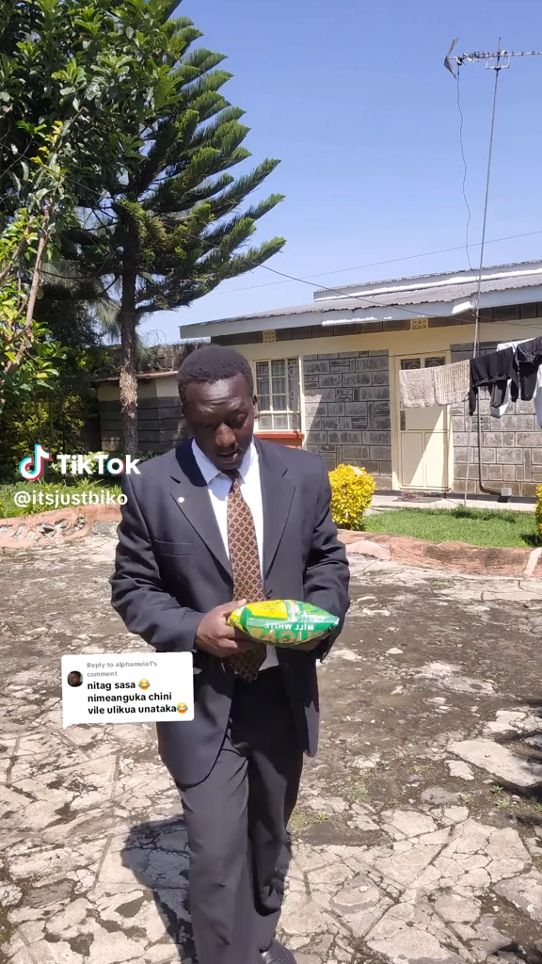
INFLATION TRACKER Ctrl_Z – Shilingi AI

Slide 2






THE TEAM
Jeff Kandie
ML- Engineer
Ann Felicity
Team Leader
Ben Kiprono
Data Analyst
Henry Njoroge
Data Engineer
Faith Wambugu
Data Analyst
Stanley Njihia
BI Developer

Slide 3
Problem statement
Current Situation:
Kenya faces significant challenges in predicting and managing commodity price volatility.
Current manual analysis methods lack predictive accuracy and timeliness.
Core Problem:
Inability to accurately forecast commodity price movements and overall inflation trends 3-12 months in advance.
Why It Matters:
Food and energy prices constitute 58.7% of the typical Kenyan household consumption basket.
Unanticipated inflation spikes have led to significant economic impacts.

Slide 4
Our solution – The Inflation Tracker
Introducing the Inflation Tracker: A data-driven platform that uses machine learning to forecast commodity prices and inflation trends in Kenya.
Our Mission: To provide accurate, timely, and accessible price predictions, empowering consumers, businesses, and policymakers to make informed financial decisions.
Key Features:
3-12 Month Forecasts: Predictive models for key commodity categories.
Interactive Dashboard: Visualize historical trends and future projections.
User-Friendly Interface: Accessible via web and mobile.

Slide 5
Our Methodology
Data Collection
KNBS Data
Data Processing
Clean missing values
ML Modeling
Processing
Dashboard
Interactive visuals
Handle outliers
Feature engineering
Success metrics
Forecasts
Real-time
Building models
Market surveys
FINDINGS>

Slide 6
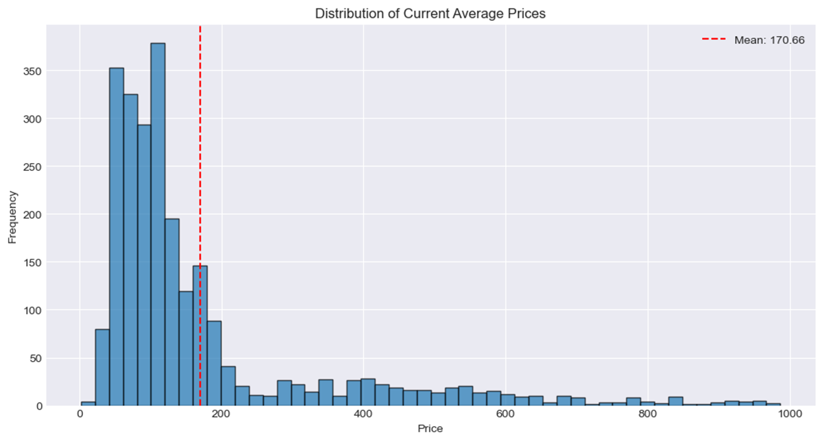
Most everyday items are affordable, but major expenses (like housing, energy, transportation) create a long tail of high-value commodities that significantly influence overall inflation measures.
20-most expensive products>

Slide 7
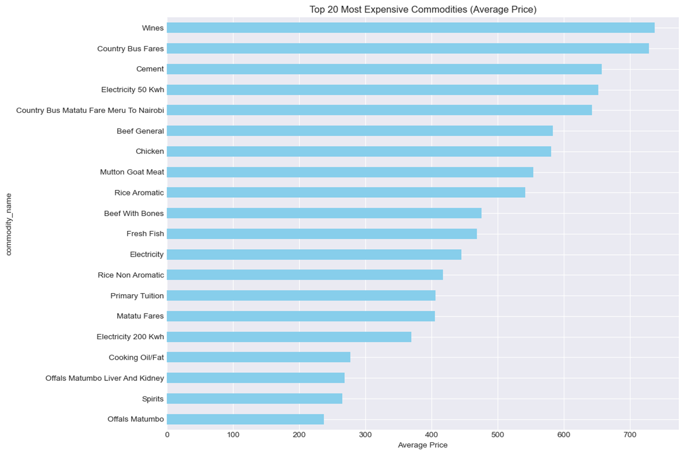
The most expensive commodities include : wines, electricity, meat and bus fares especially over long distances.
Average price/month>

Slide 8
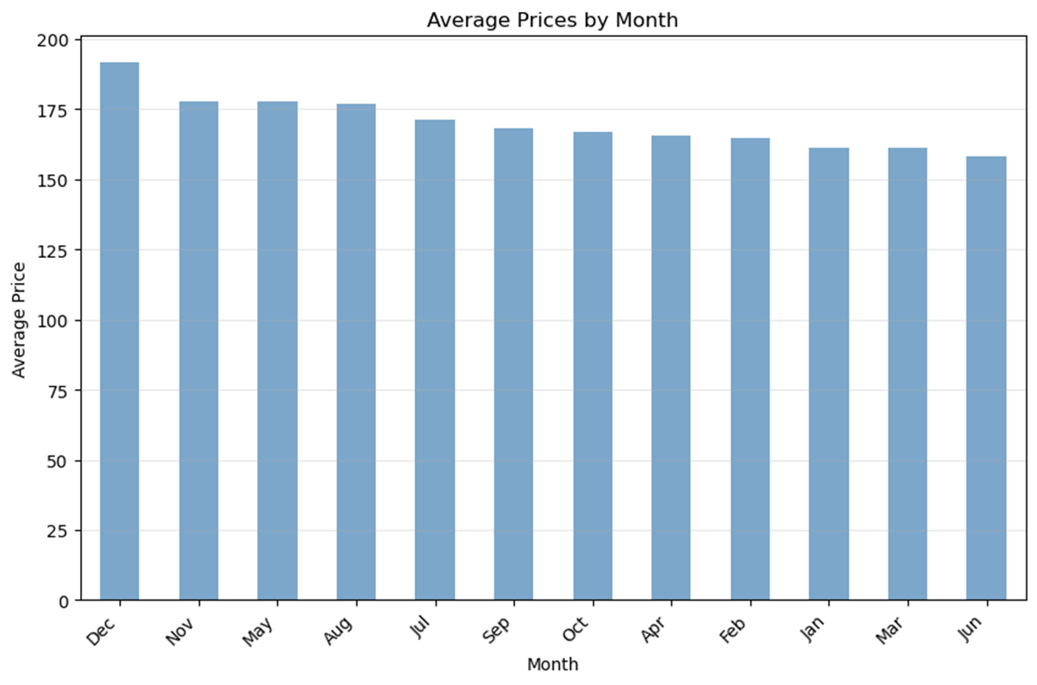
Prices are highest at the end of the year and lowest as we approach mid-year.
Commodity prices>

Slide 9
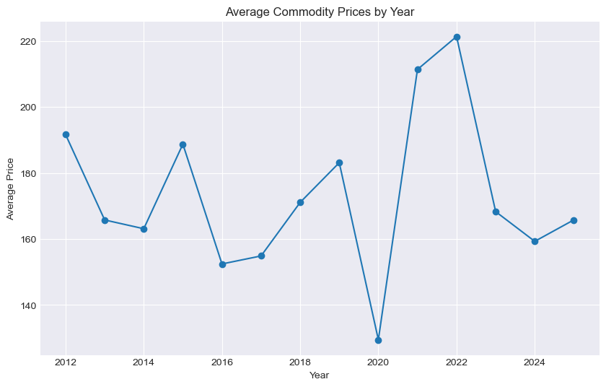
Over the years, prices were lowest in 2020, due to the Covid-19 global pandemic.
Top products>
Notes:
gggggg

Slide 10
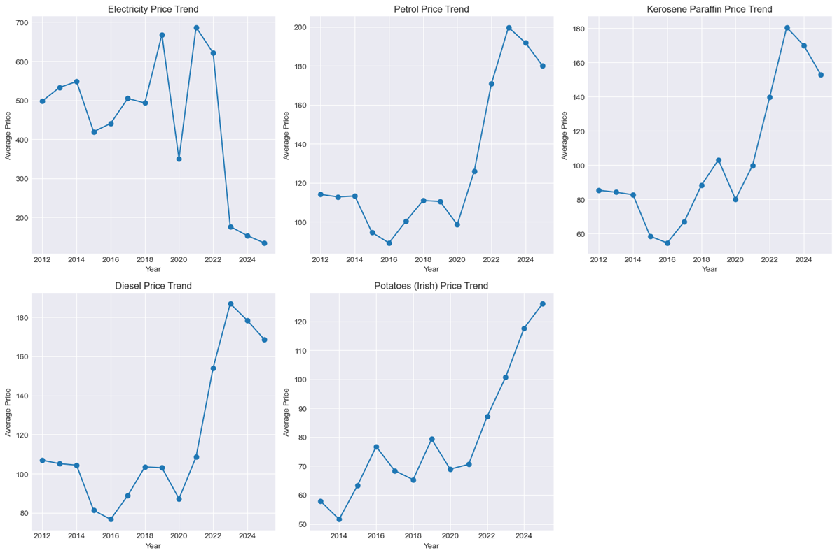
Key spikes: 2021–2022 due to global energy crisis and Russia-Ukraine war. Recent trend: Post-2023 correction as oil prices stabilize and government interventions take effect.
Crude oil prices are the primary driver of inflationary trends in Kenya, influencing electricity, petrol, diesel, and kerosene prices directly.
Food prices (potatoes) are indirectly affected through transport and input costs.
Price trends>

Slide 11
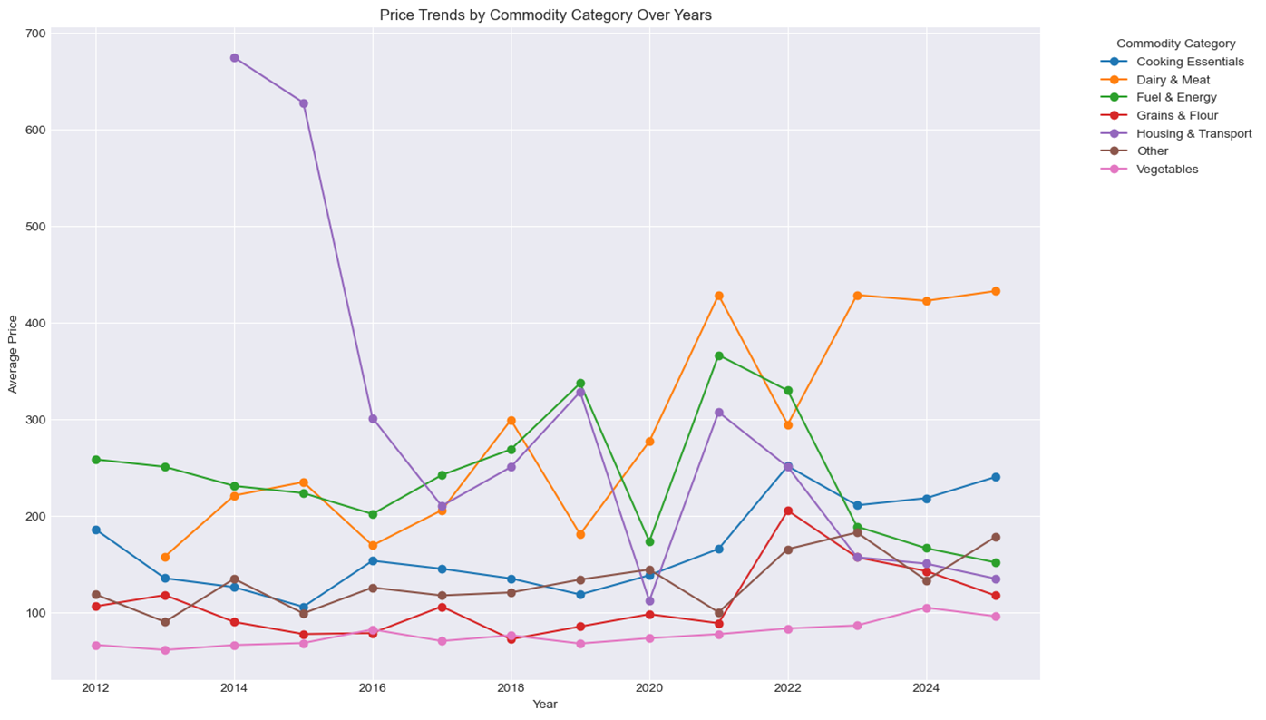
Vegetables, Grains and Flour are the least priced commodity categories over the years while Fuel & Energy and Dairy & Meat are consistently the highest priced.
Models>

Slide 12
MODEL PERFORMANCE
Model | CPI MAPE (%) | Commodity MAPE (%) | Classification F1 | Clustering Insight | Production Ready | Justification
Prophet | 0.84 | 0.1–0.3 | N/A | N/A | Yes | World-class accuracy; captures seasonality; production-ready
XGBoost | 17.94 | 3.85 | 0.9975 | N/A | Yes | Excellent for complex patterns; high F1 classification; interpretable
Linear Regression | 15.89 | 3.34 | N/A | N/A | Yes | Interpretable; fast baseline; stakeholder communication
Logistic Regression | N/A | N/A | 0.9497 | N/A | Yes | Interpretable classification; risk monitoring
Ultimate Stacking | 15.09 | 3.7 | 1 | N/A | Partial | Ensemble improves commodity prediction; fallback used for CPI
Previous Stacking | 14.25 | 5.47 | 1 | N/A | Yes | Stable ensemble; secondary use case
Random Forest | N/A | N/A | N/A | N/A | Yes | Baseline predictions; supports initial understanding
K-Means (Clustering) | N/A | N/A | N/A | 5 clear clusters – market segmentation | Yes | Segments commodities into meaningful clusters; useful for strategy
BEST MODELS
The combination of Prophet, XGBoost, and K-Means provides a robust, production-ready analytics stack
Prophet - Best accuracy for CPI & commodities, captures seasonality, production-ready
XGBoost - Excellent for classification and complex non-linear patterns
K-Means - Identifies commodity clusters, supports targeted forecasting and strategy

Slide 13
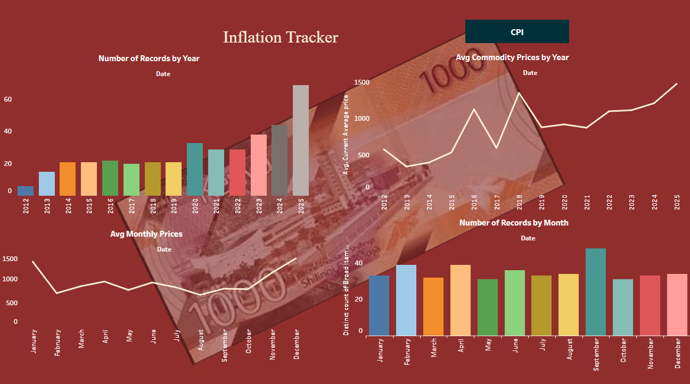
Inflation_Tracker Tableau Public

Slide 14
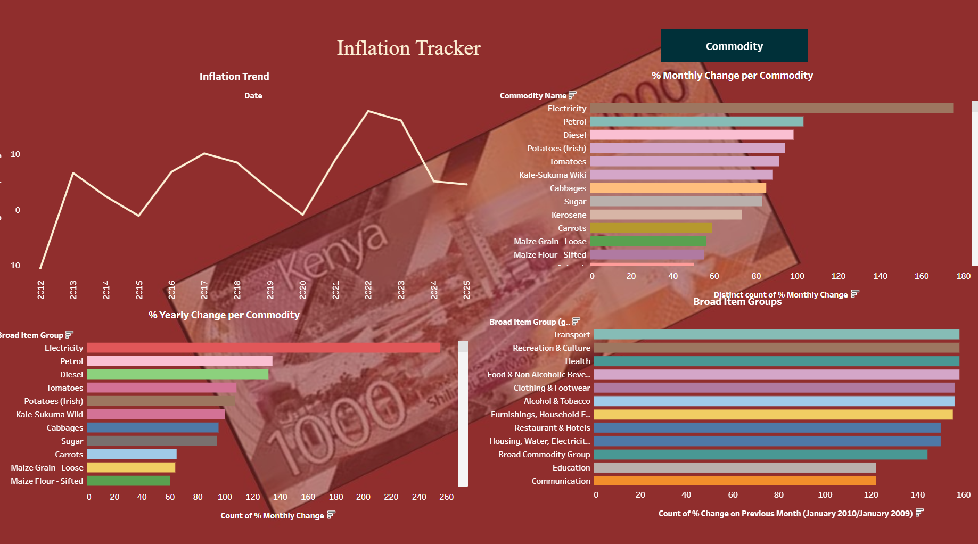

Slide 15
Benefits & Impact
Consumers
Plan budgets effectively
Businesses
Optimize inventory
Policymakers
Design targeted interventions
Anticipate major expenses
Make informed purchasing decisions
Manage supply chain
Improve pricing strategies
Monitor economic stability
Data-driven decision making

Slide 16
Conclusion & Next Steps
Next steps
Now: Deploy the model
Phase-1: Enhance the model by providing county-specific forecasts
Phase-2: Develop SMS Alert System- to increase accessibility.
Future: National partnerships.
The Inflation Tracker provides a critical solution to Kenya's challenge of commodity price volatility, transforming raw data into actionable intelligence.
Shilingi Ai - a Hugging Face Space by Lenteta

Slide 17
THANK YOU
Any questions?

